Slide 1



😊Emotify 🎷
AI-Powered Emotion Recognition & Music Recommendation
Prepared By:-The Syntax consolerZ

Slide 2
Introduction: Personalized Music Experience
Imagine a music player that understands how you feel and creates playlists tailored to your mood.
This revolutionary technology uses AI and machine learning to deliver a truly personalized music experience.

Slide 3
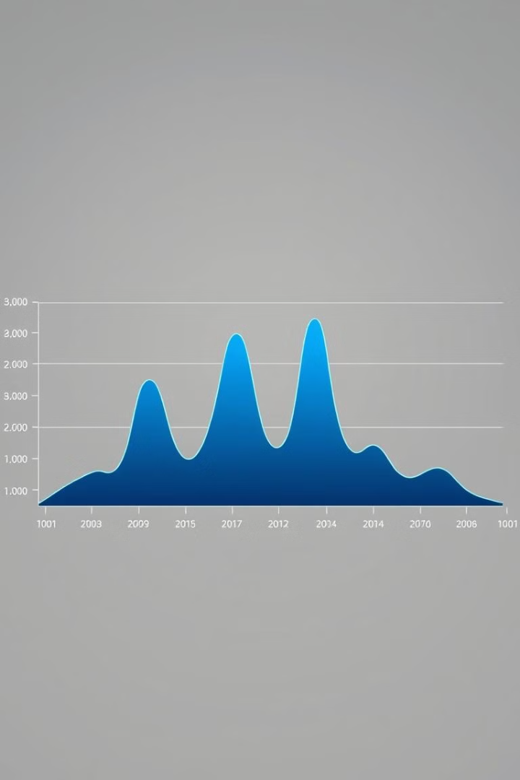
Understanding Mood Detection
Facial Recognition
Voice Analysis
Analyzing facial expressions for clues about emotions.
Detecting variations in tone and pitch to gauge emotional state.
Music Preferences
Learning your preferred music styles to understand your overall mood.

Slide 4
PROJECT DEMO

Slide 5
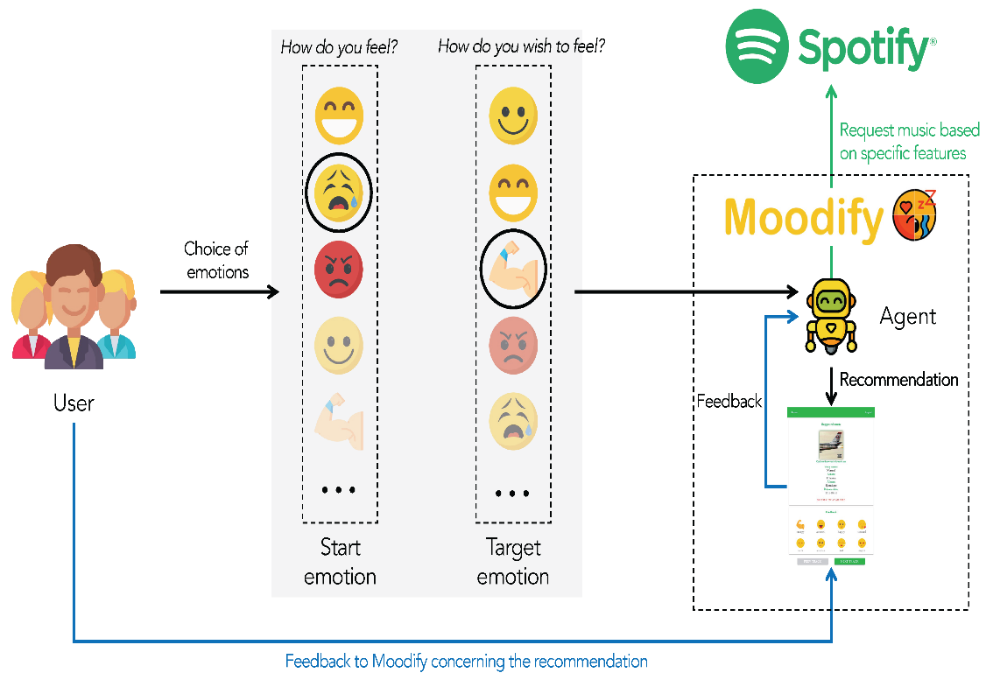
🔄️ Process Flow🔄️

Slide 6




How the AI Works in App
Face Detection
Your webcam captures frames and processes them using OpenCV (cv2)
Emotion Analysis
The frame is passed to DeepFace.analyze(), which predicts the dominant emotion.
Music Recommendation
Based on the detected emotion, your app fetches an appropriate Spotify playlist.

Slide 7




Integrating Music Libraries and APIs
Spotify API
Apple Music API
Access to a vast library of music.
Integration with another major music platform.
YouTube Music API
Seamless access to video and audio content.

Slide 8
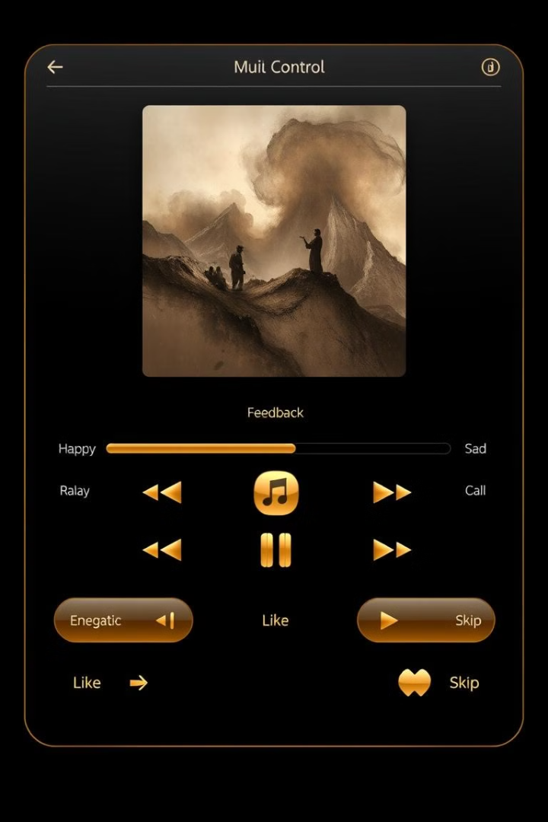
Future Enhancements
Voice-Based
Mobile App Development
Analyze tone of voice for better mood detection.
Convert into
Android/iOS app.
Integration with More Music Apps
YouTube Music, Apple Music, etc

Slide 9
Conclusion
Emotify- AI is an innovative AI-powered music recommendation system that enhances user experience.
1
Combining AI, OpenCV, Flask, and React, it offers a seamless and fun way to listen to music based on mood.
2
Future improvements can make it more accurate, scalable, and widely accessible.
3

Slide 10




Potential Applications and Use Cases

Slide 11
THANK YOU

